Slide 1
PERSOL

Slide 2
Student Name: Faizan Nadeem
Student ID: 1481533
Batch Code: PRE-2023-06E
Faculty: Sir Hassan

Slide 3
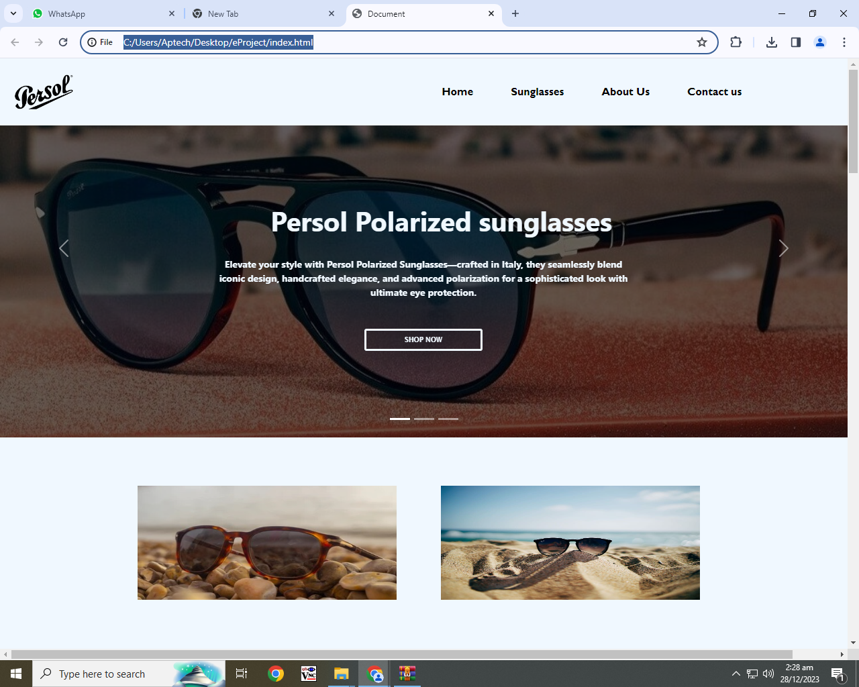
HOME PAGE

Slide 4
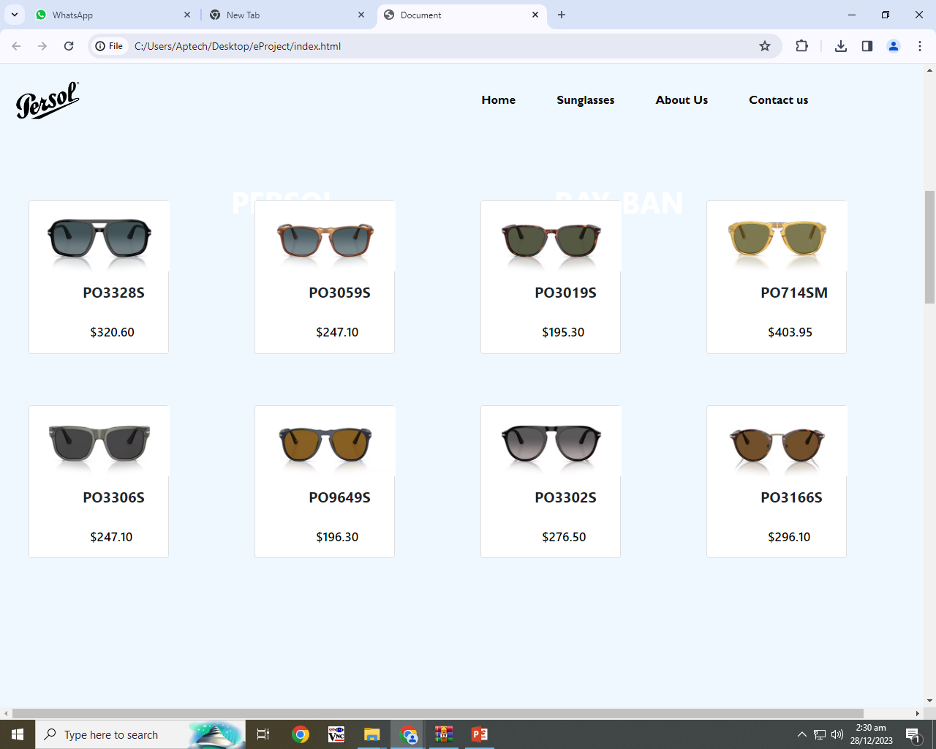
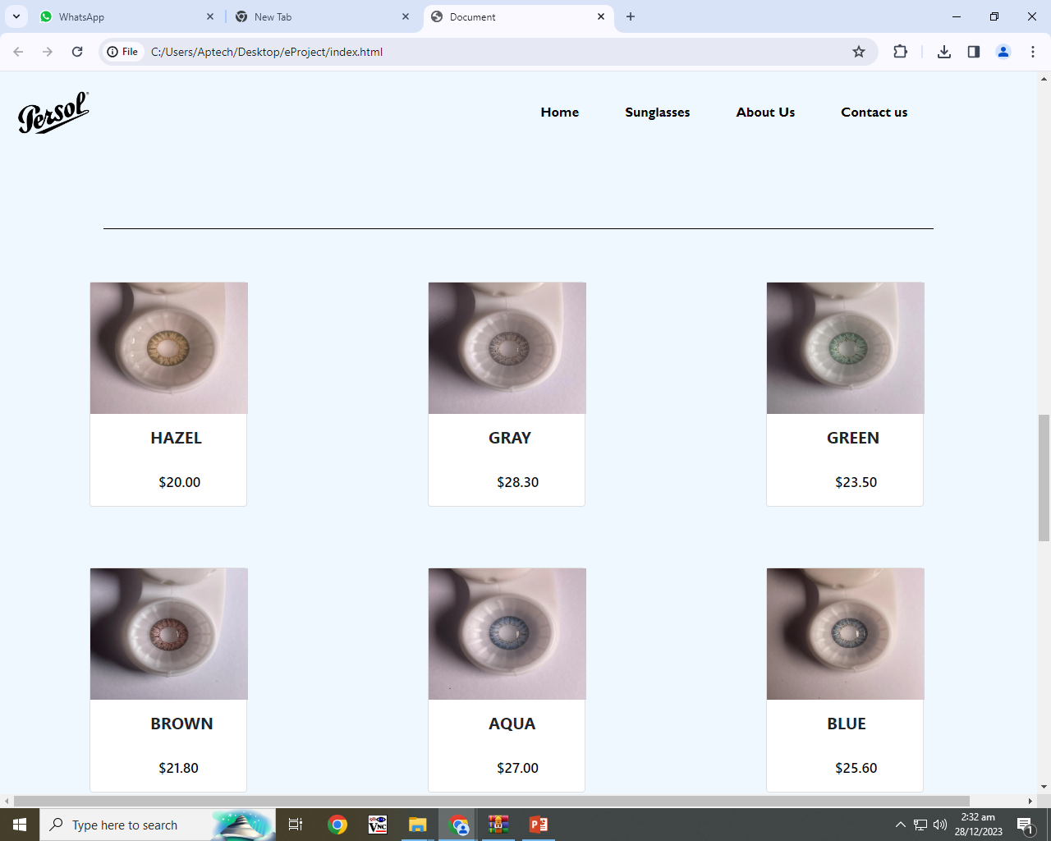
PRODUCTS

Slide 5
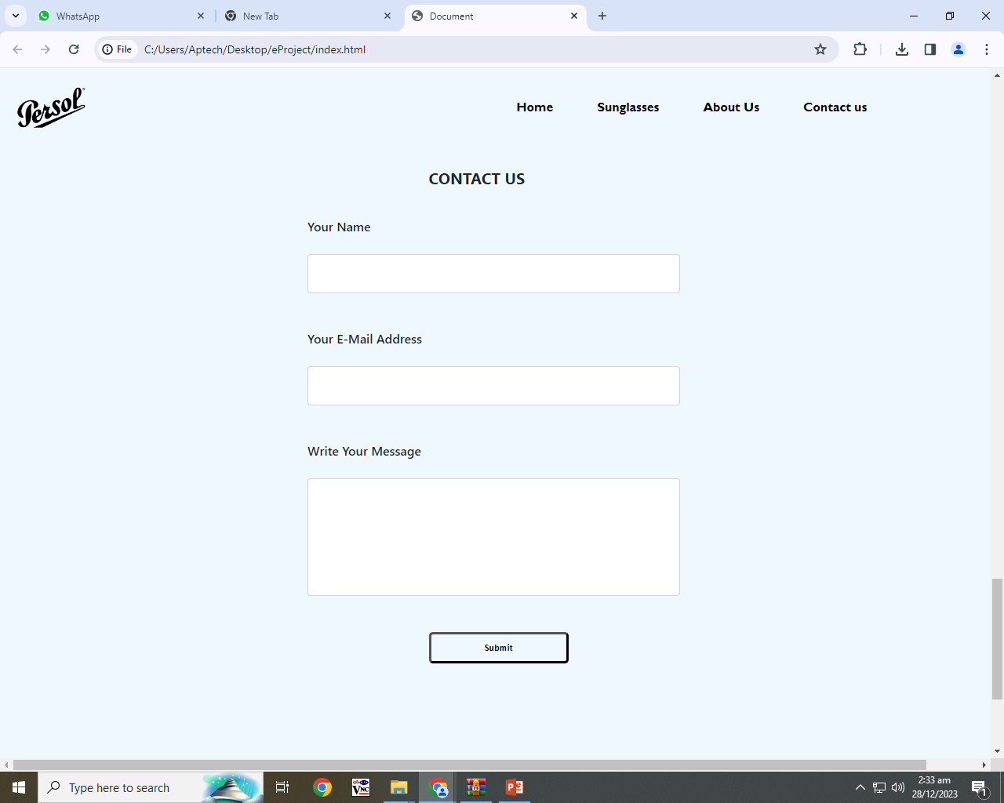
CONTACT US

Slide 6


